Slide 1
IBM Data Science
Capstone Project

Slide 2
Background
New York City's demographics show that it is a large and ethnically diverse metropolis. Being the largest city in the United States with a long history of international immigration, New York City was home to nearly 8.5 million people in 2014, accounting for over 40% of the population of New York State and a slightly lower percentage of the New York metropolitan area, home to approximately 23.6 million. New York City continues to grow over the last decade, and the region continues to be by far the leading metropolitan gateway for legal immigrants admitted into the United States.
New York City has been a major point of entry for immigrants. The term "melting pot" was coined to describe densely populated immigrant neighborhoods on the Lower East Side. There are close to 800 languages are spoken in New York, making it the most linguistically diverse city in the world. While English remains the most widely spoken language, there are areas in the outer boroughs in which close to 25% of people speak English as an alternate language, and/or have limited or no English language fluency. English is least spoken in neighborhoods such as Flushing, Sunset Park, and Corona.

Slide 3
Introduction
We are looking at opening a restaurant - but where could we open it? Hence, we explore the different restaurants distribution in two different cities, New York City and Toronto.
Queries that can be answered using above dataset
What is best location in New York City for Indian Cuisine ?
Which areas have potential Indian Resturant Market ?
Which all areas lack Indian Resturants ?
Which is the best place to stay if I prefer Indian Cuisine ?

Slide 4
Data and Required Libraries
To choose the restaurant, we will need to access following data:
neighbourhoods in New York And Toronto
from the table above, we will use the data to build our analysis. We will use FourSquare APIs for the coordinates data(latitude, longitude) in New York City and Toronto.
From FourSquare, we will need following venues data:
the school information
different restaurant information
These data will be used to analysed to determine which location is the best suited to set up the restaurant.
pandas and numpy for handling data.
request module for using FourSquare API.
geopy to get co-ordinates of City of New York.
folium to visualize the results on a map

Slide 5
Approach
Collect the new york city data from https://cocl.us/new_york_dataset
Using FourSquare API we will find all venues for each neighborhood.
Filter out all venues that are Indian Resturants.
Find rating , tips and like count for each Indian Resturants using FourSquare API.
Using rating for each resturant , we will sort that data.
Visualize the Ranking of neighborhoods using folium library(python)

Slide 6
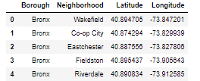
Step 1
Load data from https://cocl.us/new_york_dataset in pandas Data Frame
Get Latitude and Longtitude for each address in GeoPy Libray

Slide 7
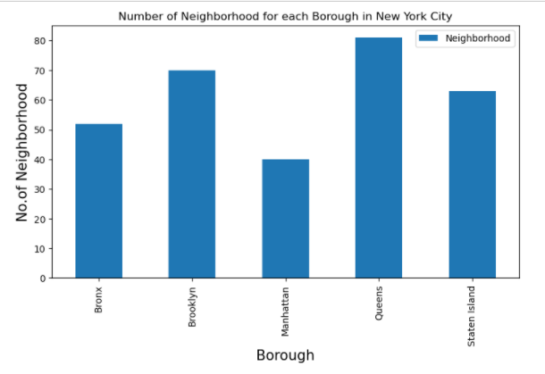
Number of Neighbourhoods in each Borough

Slide 8
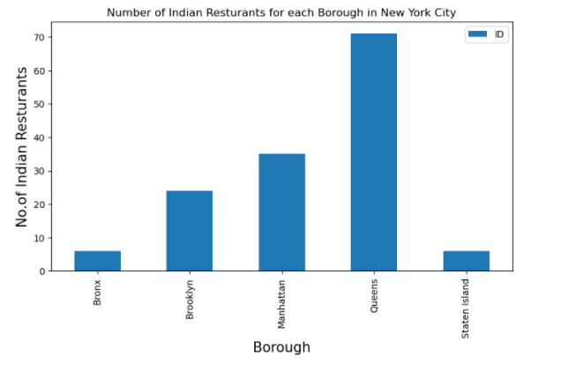
Step 2
Filter out which Borough and Neighbourhood have maximum number of Indian Restaurants using FourSquare API
Result: Queens has the most number of Restaurants

Slide 9
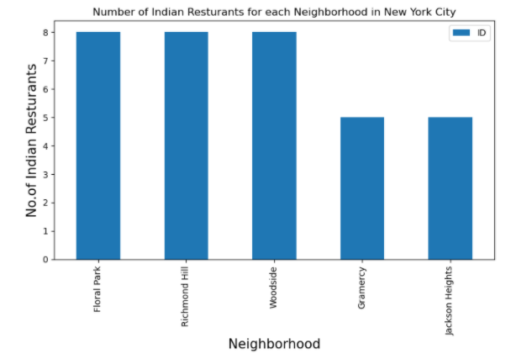
Step 2
Filter out which Borough and Neighbourhood have highest number of Indian Restaurants using FourSquare API
Result: Floral Park, Richmond Hill & Woodside have the most number of Restaurants

Slide 10
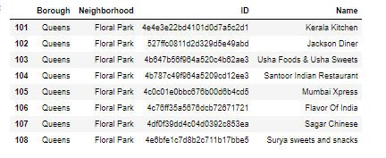
List of Restaurants in Floral Park

Slide 11
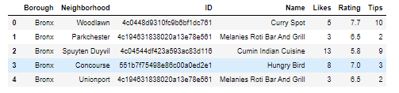
Step 3
Using FourSquare API, retrieve info likes, ratings and tips on each Indian Restaurant

Slide 12
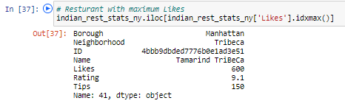
Result
Indian Restaurant with the most likes

Slide 13
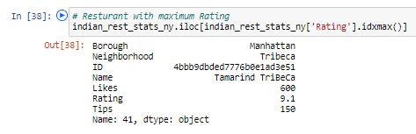
Result
Indian Restaurant with the highest ratings

Slide 14
Conclusion
Best neighbourhoods for Indian cuisine: Astoria(Queens), Blissville(Queens), Civic Center(Manhattan)
Potential market for Indian restaurant: Manhatten
Lowest rating for Indian Restaurants: Staten Island
Best place to stay for Indian Cuisine: Manhatten
Limitation: Information limited to accuracy of data provided by FourSquare
Conclusion

Slide 15
Conclusion
Best neighbourhoods for Indian cuisine: Astoria(Queens), Blissville(Queens), Civic Center(Manhattan)
Potential market for Indian restaurant: Manhatten
Lowest rating for Indian Restaurants: Staten Island
Best place to stay for Indian Cuisine: Manhatten
Conclusion

